Slide 1
CHAPTER - V DATA FILE HANDLING

Slide 2
LEARNING OUTCOMES
After going through the chapter, student will be able to:
Understand the importance of data file for permanent storage of data.
Understand how standard Input/Output function work.
Distinguish between text and binary file
Open and close a file ( text and binary)
Read and write data in file
Write programs that manipulate data file(s

Slide 3
INTRODUCTION – DATA FILES
A file (i.e. data file) is a named place on the disk where a sequence of related data is stored.
In python files are simply stream of data, so the structure of data is not stored in the file, along with data.

Slide 4
BASIC OPERATIONS ON FILE

Slide 5
BASIC OPERATIONS ON FILE
Basic operations performed on a data file are:
1. Naming a file
2. Opening a file
3. Reading data from the file
4. Writing data in the file
5. Closing a file

Slide 6
FILE PROCESSING
Contd.. next

Slide 7
FILE PROCESSING
Using these basic operations, we can process file in many ways, such as
1. CREATING A FILE
2. TRAVERSING A FILE FOR DISPLAYING THE DATA ON SCREEN
3. APPENDING DATA IN FILE
4. INSERTING DATA IN FILE
Contd.. next

Slide 8
INTRODUCTION – DATA FILES
5. DELETING DATA FROM FILE
6. CREATE A COPY OF FILE
7. UPDATING DATA IN THE FILE … etc

Slide 9
TYPES OF FILES

Slide 10
TYPES OF FILES
Python allow us to create and manage two types of file
1. TEXT FILE
2. BINARY FILE

Slide 11
1. TEXT FILE
What is Text File?
A text file is usually considered as sequence of lines. Line is a sequence of characters (ASCII or UNICODE), stored on permanent storage media. The default character coding in python is ASCII each line is terminated by a special character, known as End of Line (EOL). At the lowest level, text file will be collection of bytes. Text files are stored in human readable form and they can also be created using any text editor.

Slide 12
2. BINARY FILE
What is Binary File?
A binary file contains arbitrary binary data i.e. numbers stored in the file, can be used for numerical operation(s). So when we work on binary file, we have to interpret the raw bit pattern(s) read from the file into correct type of data in our program. In the case of binary file it is extremely important that we interpret the correct data type while reading the file. Python provides special module(s) for encoding and decoding of data for binary file.

Slide 13
OPENING AND CLOSING FILES

Slide 14
OPENING AND CLOSING FILES
To handle data files in python, we need to have a file object. Object can be created by using open() function or file() function.
To work on file, first thing we do is open it. This is done by using built in function open().
Syntax of open() function is
file_object = open(filename [, access_mode] [,buffering])

Slide 15
OPENING AND CLOSING FILES
open() requires three arguments to work,
first one ( filename ) is the name of the file on secondary storage media, which can be string constant or a variable. The name can include the description of path, in case, the file does not reside in the same folder / directory in which we are working
The second parameter (access_mode) describes how file will be used throughout the program. This is an optional parameter and the default access_mode is reading.

Slide 16
OPENING AND CLOSING FILES
The third parameter (buffering) is for specifying how much is read from the file in one read.
Finally, The function will return an object of file type using which we will manipulate the file, in our program.
When we work with file(s), a buffer (area in memory where data is temporarily stored before being written to file), is automatically associated with file when we open the file.

Slide 17
OPENING AND CLOSING FILES
While writing the content in the file, first it goes to buffer and once the buffer is full, data is written to the file. Also when file is closed, any unsaved data is transferred to file. flush() function is used to force transfer of data from buffer to file

Slide 18
FILE ACCESS MODES

Slide 19
FILE ACCESS MODES
MODE | File Opens in
r | Text File Read Mode
rb | Binary File Read Mode
These are the default modes. The file pointer is placed at the beginning for reading purpose, when we open a file in this mode.

Slide 20
FILE ACCESS MODES
MODE | File Opens in
r+ | Text File Read & Write Mode
rb+ | Binary File Read Write Mode
w | Text file write mode
wb | Text and Binary File Write Mode
w+ | Text File Read and Write Mode
wb+ | Text and Binary File Read and Write Mode
a | Appends text file at the end of file, if file does not exists it creates the file.

Slide 21
FILE ACCESS MODES
MODE | File Opens in
ab | Appends both text and binary files at the end of file, if file does not exists it creates the file.
a+ | Text file appending and reading.
ab+ | Text and Binary file for appending and reading.

Slide 22
FILE ACCESS MODES - EXAMPLE
For Ex:
f=open(“notes.txt”, ‘r’)
This is the default mode for a file.
notes.txt is a text file and is opened in read mode only.

Slide 23
FILE ACCESS MODES - EXAMPLE
For Ex:
f=open(“notes.txt”, ‘r+’)
notes.txt is a text file and is opened in read and write mode.

Slide 24
FILE ACCESS MODES - EXAMPLE
For Ex:
f=open(“tests.dat ”, ‘rb’)
tests.dat is a binary file and is opened in read only mode.

Slide 25
FILE ACCESS MODES - EXAMPLE
For Ex:
f=open(“tests.dat”, ‘rb+’)
tests.dat is binary file and is opened in both modes that is reading and writing.

Slide 26
FILE ACCESS MODES - EXAMPLE
For Ex:
f=open(“tests.dat”, ‘ab+’)
tests.dat is binary file and is opened in both modes that is reading and appending.

Slide 27
close FUNCTION

Slide 28
close FUNCTION
fileobject. close() will be used to close the file object, once we have finished working on it. The method will free up all the system resources used by the file, this means that once file is closed, we will not be able to use the file object any more.
For example:
f.close()

Slide 29
FILE READING METHODS

Slide 30
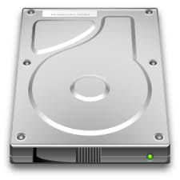

FILE READING METHODS
PYTHON PROGRAM
A Program reads a text/binary file from hard disk. File acts like an input to a program.

Slide 31
FILE READING METHODS
Followings are the methods to read a data from the file.
1. readline() METHOD
2. readlines() METHOD
3. read() METHOD

Slide 32
readline() METHOD
readline() will return a line read, as a string from the file. First call to function will return first line, second call next line and so on.
It's syntax is,
fileobject.readline()

Slide 33
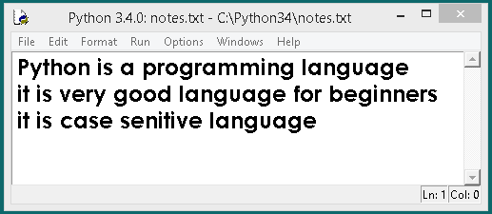
readline() EXAMPLE
First create a text file and save under filename notes.txt

Slide 34
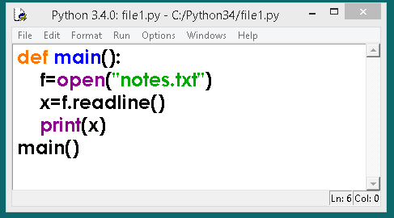
readline() EXAMPLE

Slide 35
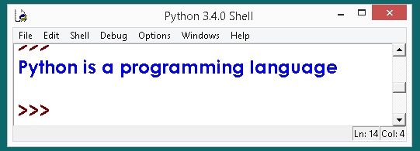
readline() EXAMPLE O/P
readline() will return only one line from a file, but notes.txt file containing three lines of text

Slide 36
readlines() METHOD
readlines()can be used to read the entire content of the file. You need to be careful while using it w.r.t. size of memory required before using the function. The method will return a list of strings, each separated by \n. An example of reading entire data of file in list is:
It's syntax is,
fileobject.readlines()
as it returns a list, which can then be used for manipulation.

Slide 37
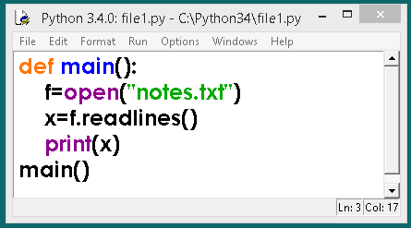
readlines() EXAMPLE

Slide 38
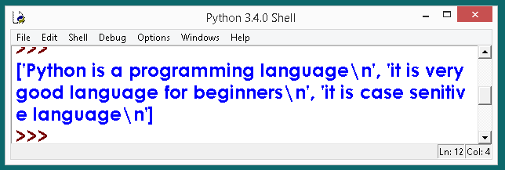
readlines() EXAMPLE
The readlines() method will return a list of strings, each separated by \n

Slide 39
read() METHOD
The read() method is used to read entire file
The syntax is:
fileobject.read()
For example
Contd…

Slide 40
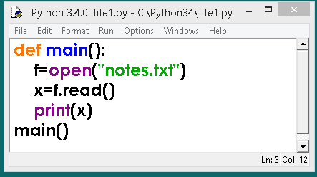
read() METHOD EXAMPLE

Slide 41
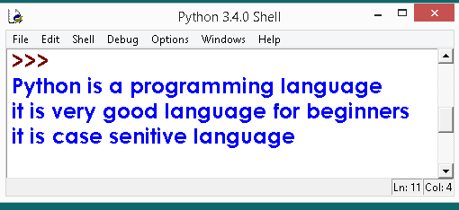
read() METHOD EXAMPLE O/P
The read() method will return entire file.

Slide 42
read(size) METHOD

Slide 43
read(size) METHOD
read() can be used to read specific size string from file. This function also returns a string read from the file.
Syntax of read() function is:
fileobject.read([size])
For Example:
f.read(1) will read single byte or character from a file.

Slide 44
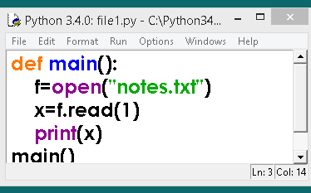
read(size) METHOD EXAMPLE
f.read(1) will read single byte or character from a file and assigns to x.

Slide 45
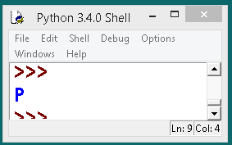
read(size) METHOD EXAMPLE O/P

Slide 46
WRITING IN TO FILE

Slide 47
WRITING METHODS
PYTHON PROGRAM
A Program writes into a text/binary file from hard disk.

Slide 48
WRITING METHODS
1. write () METHOD
2. writelines() METHOD

Slide 49
1. write () METHOD
For sending data in file, i.e. to create / write in the file, write() and writelines() methods can be used.
write() method takes a string ( as parameter ) and writes it in the file.
For storing data with end of line character, you will have to add \n character to end of the string

Slide 50
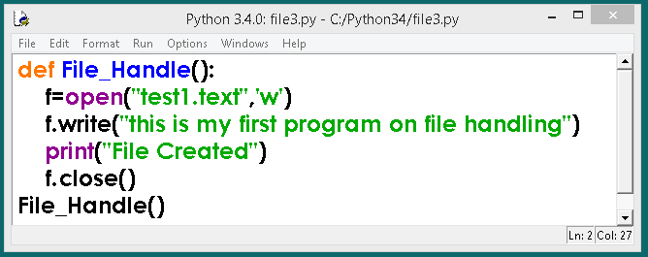
1. write () METHOD EXAMPLE
Use ‘a’ in open function to append or add the information to the file. ‘a+’ to add as well as read the file.

Slide 51
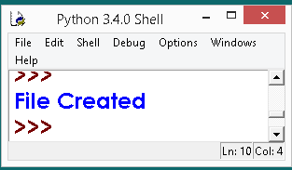
1. write () METHOD EXAMPLE
if you execute the program n times, the file is opened in w mode meaning it deletes content of file and writes fresh every time you run.

Slide 52
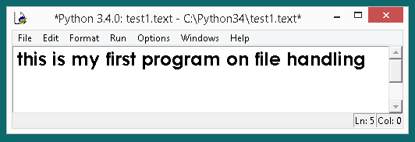
1. write () METHOD EXAMPLE O/P
if you execute the program n times, the file is opened in w mode meaning it deletes content of file and writes fresh every time you run.

Slide 53
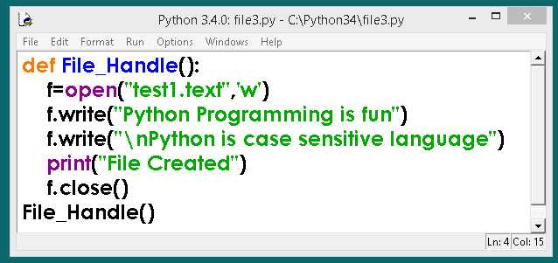
1. write () METHOD EXAMPLE 2
now content of test1.txt is changed because the file is opened in w mode and this mode deletes all content and writes fresh if file exists. \n write to next line. If not used it writes on the same line.

Slide 54
1. write () METHOD EXAMPLE 2
So test1.txt is already exists in harddisk and it deletes all content and writes fresh. If file not found it creates new file.

Slide 55
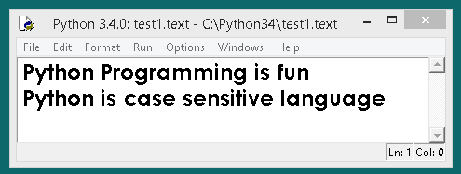
1. write () METHOD EXAMPLE 2
So test1.txt is already exists in harddisk and it deletes all content and writes fresh. If file not found it creates new file.

Slide 56
2. writelines() METHOD
For writing a string at a time, we use write() method, it can't be used for writing a list, tuple etc. into a file.
Sequence data type can be written using writelines() method in the file. It's not that, we can't write a string using writelines() method.
It's syntax is:
fileobject.writelines(seq)

Slide 57
2. writelines() METHOD
So, whenever we have to write a sequence of string / data type, we will use writelines(), instead of write().
Example:
f = open('test2.txt','w')
str = 'hello world.\n this is my first file handling program.\n I am using python language"
f.writelines(str)
f.close()

Slide 58
RANDOM ACCESS METHODS

Slide 59
RANDOM ACCESS METHODS
All reading and writing functions discussed till now, work sequentially in the file. To access the contents of file randomly –following methods are use.
seek method
tell method

Slide 60
seek method
seek()method can be used to position the file object at particular place in the file.
It's syntax is :
fileobject.seek(offset [, from_what])
here offset is used to calculate the position of fileobject in the file in bytes. Offset is added to from_what (reference point) to get the position. Following is the list of from_what values:

Slide 61
seek method
Value reference point
0 beginning of the file
1 current position of file
end of file
default value of from_what is 0, i.e. beginning of the file.

Slide 62
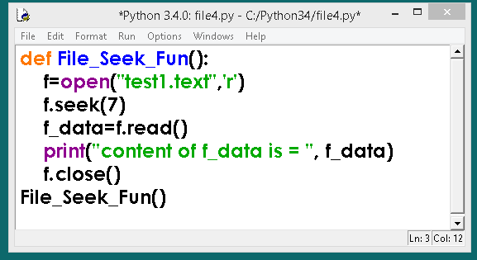
seek method
f.seek(7) keeps file pointer at reads the file content from 8th position onwards to till EOF.

Slide 63
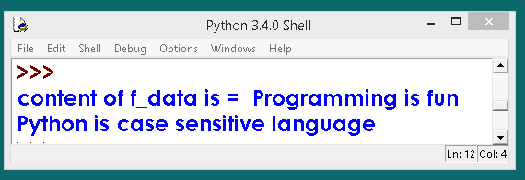
seek method
Results: - So 8th position onwards to till EOF.

Slide 64

Reading according to size
In the input function if you specify the number of bytes that many number of bytes can be fetched and assigned to an identifier.

Slide 65
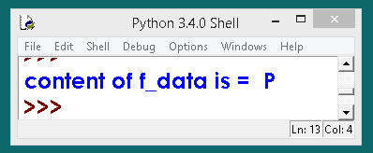
Reading according to size
f.read(1) will read single byte/ character starting from byte number 8. hence byte number 8 is P so one character/byte is fetched and assigned to f_data identifier.

Slide 66
Reading according to size
f.read(2) - will read 2 chars/bytes
f.read(4) - will read 4 chars/bytes
and so on..

Slide 67
tell method
tell() method returns an integer giving the current position of object in the file. The integer returned specifies the number of bytes from the beginning of the file till the current position of file object.
It's syntax is
fileobject.tell()

Slide 68
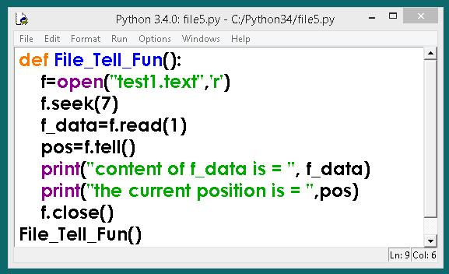
tell() method

Slide 69
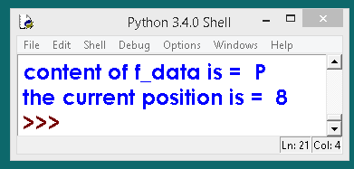
tell() method
tell() method returns an integer and assigned to pos variable. It is the current position from the beginning of file.

Slide 70
BINARY FILES

Slide 71
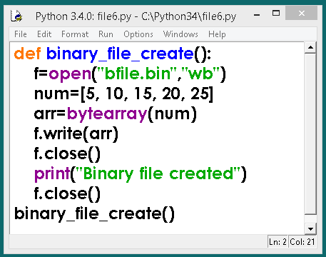
CREATING BINARY FILES

Slide 72
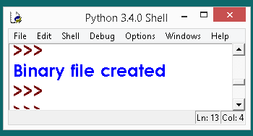
CREATING BINARY FILES

Slide 73
SEEING CONTENT OF BINARY FILE

Slide 74
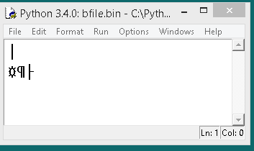
CONTENT OF BINARY FILE
Content of binary file which is in codes.

Slide 75
READING BINARY FILES TROUGH PROGRAM

Slide 76
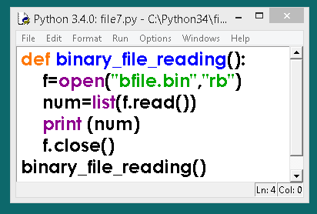
READING BINARY FILE PROGRAM

Slide 77
READING BINARY FILE PROGRAM

Slide 78
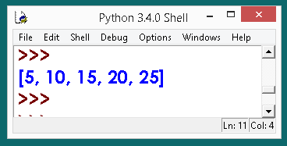
CONTENT OF BINARY FILE

Slide 79
PICKELING AND UNPICKLING USING PICKEL MODULE

Slide 80
PICKELING AND UNPICKLING USING PICKEL MODULE
Use the python module pickle for structured data such as list or directory to a file.
PICKLING refers to the process of converting the structure to a byte stream before writing to a file.
while reading the contents of the file, a reverse process called UNPICKLING is used to convert the byte stream back to the original structure.

Slide 81
PICKELING AND UNPICKLING USING PICKEL MODULE
First we need to import the module, It provides two main methods for the purpose:-
1) dump() method
2) load() method

Slide 82
pickle.dump() Method
Use pickle.dump() method to write the object in file which is opened in binary access mode.
Syntax of dump method is:
dump(object,fileobject)

Slide 83
pickle.dump() Method

Slide 84
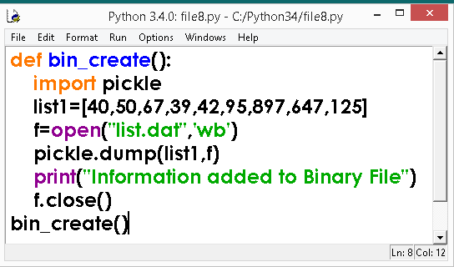
pickle.dump() Method
# A program to write list sequence in a binary file

Slide 85
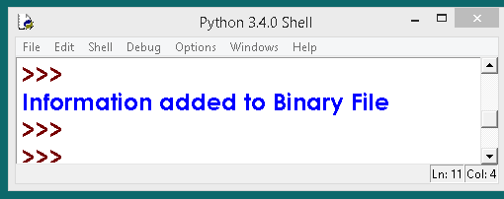
pickle.dump() Method
OUTPUT

Slide 86
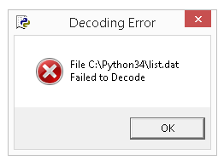
pickle.dump() Method
Once you try to open list.dat file in python editor to see the content python generates decoding error.

Slide 87
pickle.load() Method

Slide 88
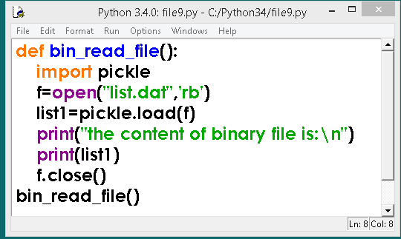
pickle.load() Method
pickle.load() method is used to read the binary file.

Slide 89

pickle.load() Method
pickle.load() method is used to read the binary file.

Slide 90
DIFFERENCE BETWEEN TEXT FILES AND BINARY FILES

Slide 91
DIFFERENCE BETWEEN TEXT FILESAND BINARY FILES

Slide 92
DIFFERENCE BETWEEN TEXT FILESAND BINARY FILES
Text Files | Binary Files
1. Text Files are sequential files | 1. A Binary file contain arbitrary binary data
2. Text files only stores texts | 2 Binary Files are used to store binary data such as image, video, audio, text
3. There is a delimiter EOL (End of Line i.e \n) | 3. There is no delimiter

Slide 93
DIFFERENCE BETWEEN TEXT FILESAND BINARY FILES
Text Files | Binary Files
4. Due to delimiter text files takes more time to process. while reading or writing operations are performed on file. | 4. No presence of delimiter makes files to process fast while reading or writing operations are performed on file.
5. Text files easy to understand because these files are in human readable form | 5. Binary files are difficult to understand.

Slide 94
DIFFERENCE BETWEEN TEXT FILESAND BINARY FILES
Text Files | Binary Files
6. Text files are having extension .txt | 6. Binary files are having .dat extension
7. Programming on text files are very easy. | 7. Programming on binary files are difficult.

Slide 95
DIFFERENCE BETWEEN TEXT FILES AND BINARY FILES
TEXT FILE | BINARY FILE
1. Bits represent character. | 1. Bits represent a custom data.
2. Less prone to get corrupt as changes reflect as soon as the file is opened and can easily be undone | 2. Can easily get corrupted, even a single bit change may corrupt the file.

Slide 96
DIFFERENCE BETWEEN TEXT FILES AND BINARY FILES
TEXT FILE | BINARY FILE
3. Can store only plain text in a file. | 3. Can store different types of data (image, audio, text) in a single file.
4. Widely used file format and can be opened using any simple text editor. | 4. Developed especially for an application and may not be understood by other applications.

Slide 97
DIFFERENCE BETWEEN TEXT FILES AND BINARY FILES
TEXT FILE | BINARY FILE
5. Mostly .txt and .rtf are used as extensions to text files. | 5. Can have any application defined extension.

Slide 98
PYTHON FILE OBJECT ATTRIBUTES

Slide 99
PYTHON FILE OBJECT ATTRIBUTES
File attributes give information about the file and file state.
Attribute | Function
name | Returns the name of the file
closed | Returns true if file is closed. False otherwise.
mode | The mode in which file is open.
softspace | Returns a Boolean that indicates whether a space character needs to be printed before another value when using the print statement.

Slide 100
OTHER METHODS OF FILEOBJECT

Slide 101
OTHER METHODS OF FILEOBJECT
Method | Function
readable() | Returns True/False whether file is readable
writable() | Returns True/False whether file is writable
fileno() | Return the Integer descriptor used by Python to request I/O operations from Operating System
flush() | Clears the internal buffer for the file.

Slide 102
OTHER METHODS OF FILEOBJECT
Method | Function
isatty() | Returns True if file is connected to a Tele-TYpewriter (TTY) device or something similar.
truncate([size) | Truncate the file, up to specified bytes.
next(iterator,[default]) | Iterate over a file when file is used as an iterator, stops iteration when reaches end-of-file (EOF) for reading.

Slide 103
HANDLING FILES THROUGH
OS MODULE

Slide 104
HANDLING FILES THROUGH
OS MODULE
The os module of Python allows you to perform Operating System dependent operations such as making a folder, listing contents of a folder, know about a process, end a process etc..
Let's see some useful os module methods that can help you to handle files and folders in your program.

Slide 105
ABSOLUTE PATH AND RELATIVE PATH

Slide 106
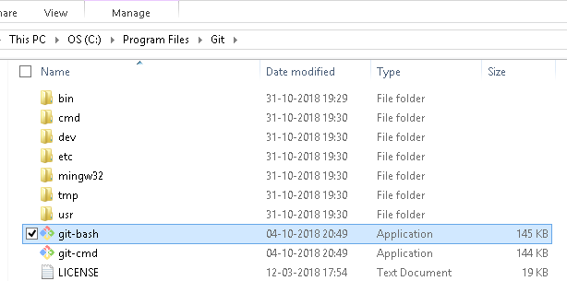
ABSOLUTE PATH
Absolute path of file is file location, where in it starts from the top most directory
ABSOLUTE PATH

Slide 107
RELATIVE PATH
Relative Path of file is file location, where in it starts from the current working directory
Myfolder\myfile.txt
RELATIVE PATH

Slide 108
HANDLING FILES THROUGH
OS MODULE
Method | Function
os.makedirs() | Create a new folder
os.listdir() | List the contents of a folder
os.getcwd() | Show current working directory
os.path.getsize() | show file size in bytes of file passed in parameter
os.path.isfile() | Is passed parameter a file
os.path.isdir() | Is passed parameter a folder
os.chdir | Change directory/folder

Slide 109
HANDLING FILES THROUGH
OS MODULE
Method | Function
os.rename(current,new) | Rename a file
os.remove(file_name) | Delete a file

Slide 110
PROGRAMS

Slide 111
PROGRAMS
1. Write a function to create a text file containing following data
Neither apple nor pine are in pineapple. Boxing rings are square.
Writers write, but fingers don't fing. Overlook and oversee are opposites. A house can burn up as it
burns down. An alarm goes off by going on.

Slide 112
PROGRAMS
2. Read back the entire file content using read() or readlines () and display on screen.
3. Append more text of your choice in the file and display the content of file with line numbers
prefixed to line.
4. Display last line of file.
Contd..

Slide 113
PROGRAMS
5. Display first line from 10th character onwards
6. Read and display a line from the file. Ask user to provide the line number to be read.

Slide 114
PROGRAMS
A text file named MATTER.TXT contains some text, which needs to be displayed such that every next character is separated by a symbol ‘#’.
Write a statement in Python to open a text file STORY.TXT so that new contents can be added at the end of it.

Slide 115
PROGRAMS
Write a method in Python to read lines from a text file INDIA.TXT, to find and display the occurrence of the word ‘‘India’’.
For example :
If the content of the file is
‘‘India is the fastest growing economy.
India is looking for more investments around the globe.
The whole world is looking at India as a great market.
Most of the Indians can foresee the heights that India is
capable of reaching.’’
The output should be 4.

Slide 116
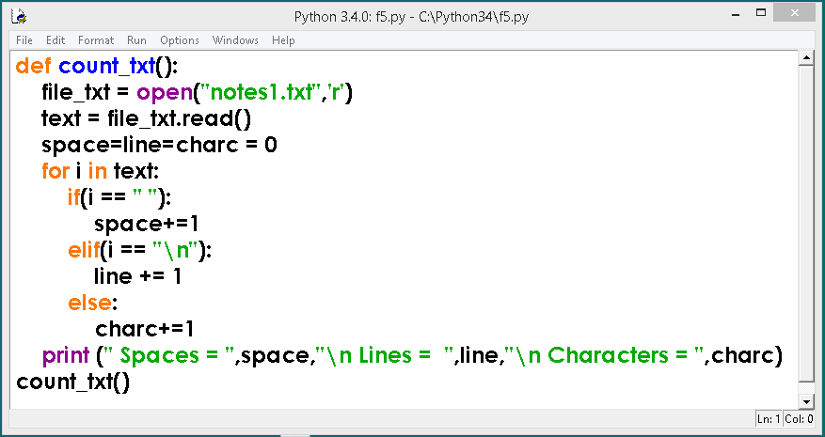
PROGRAMS
10. Write a function to count total number of spaces, lines and characters in a given line of text

Slide 117
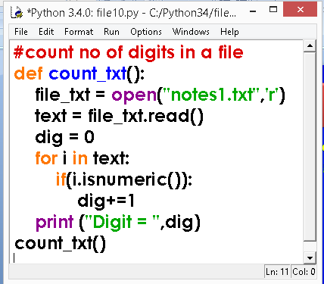
PROGRAMS
11. Write a function to count total number of digits in a given line of text

Slide 118
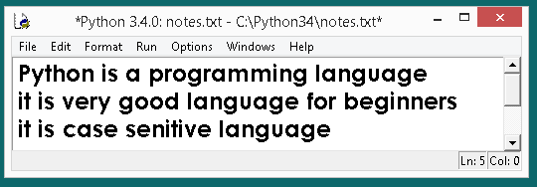
PROGRAMS
12. Write a function to copy the content of notes.txt to sub.txt
NOTES.txt FILE

Slide 119
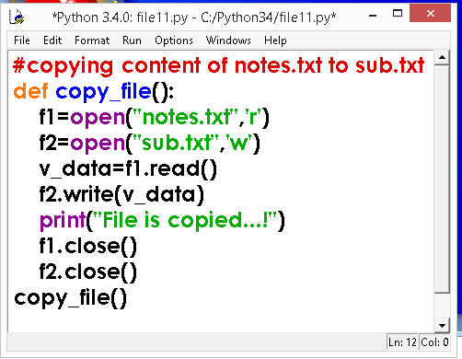
PROGRAMS
12. Write a function to copy the content of notes.txt to sub.txt

Slide 120
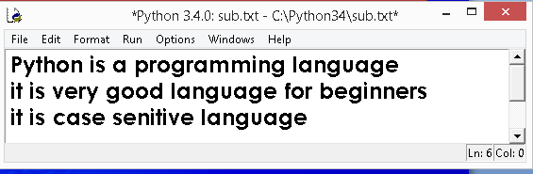
PROGRAM - OUTPUT
12. Write a function to copy the content of notes.txt to sub.txt
SUB.txt FILE

Slide 121
PROGRAM - OUTPUT
13. Write a function to append or add a line of text in notes.txt
NOTES.txt FILE

Slide 122
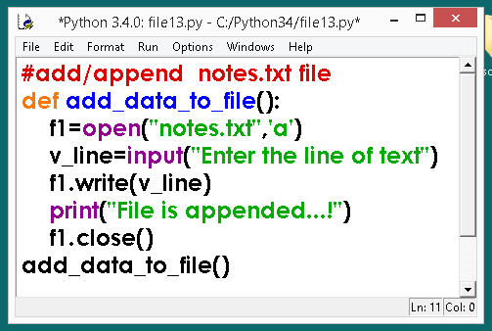
PROGRAMS
13. Write a function to append or add a line of text in notes.txt

Slide 123
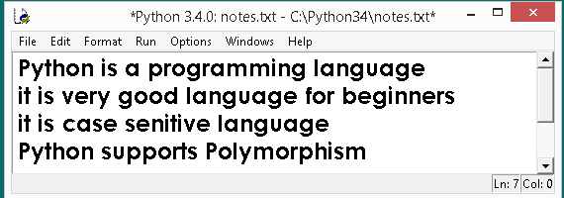
PROGRAM -OUTPUT
13. Write a function to append or add a line of text in notes.txt

Slide 124
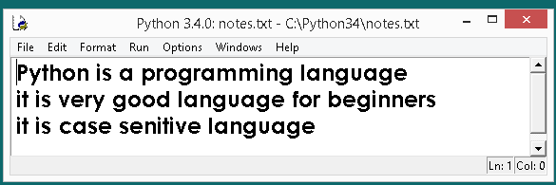
PROGRAMS
14. Write a function to display total number of lines in a notes.txt file.
NOTES.txt FILE

Slide 125
PROGRAMS
14. Write a function to display total number of lines in a notes.txt file.
NOTES.txt FILE

Slide 126
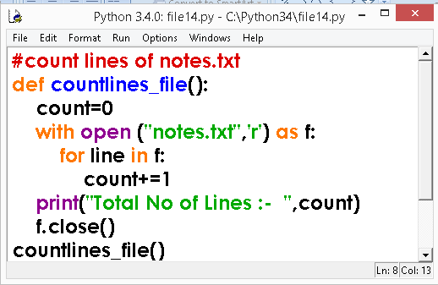
PROGRAMS
14. Write a function to display total number of lines in a notes.txt file.

Slide 127
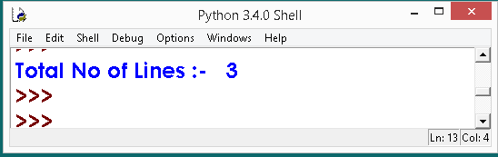
PROGRAM - OUTPUT
14. Write a function to display total number of lines in a notes.txt file.
OUTPUT

Slide 128
PROGRAMS
ANTOHER METHOD
14. Write a function in python to count the total number of lines in a file ‘Mem.txt’

Slide 129
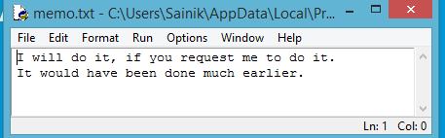
PROGRAMS
14. Write a function in python to count the total number of lines in a file ‘Mem.txt’
‘Mem.txt’ file contains

Slide 130
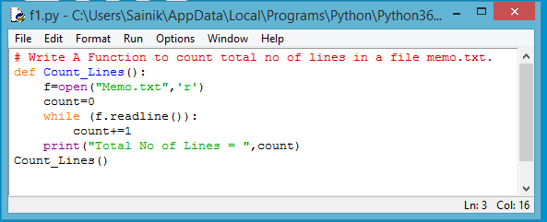
PROGRAMS
14. Write a function in python to count the total number of lines in a file ‘Mem.txt’

Slide 131
PROGRAMS
15. Write a function to display last line of notes.txt file.
NOTES.txt FILE

Slide 132
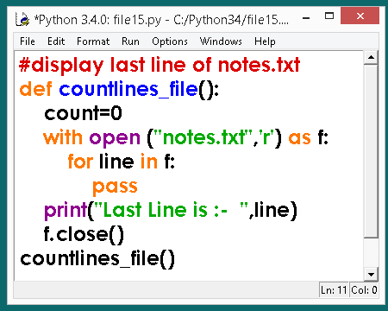
PROGRAMS
15. Write a function to display last line of notes.txt file.

Slide 133
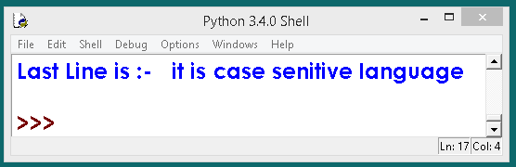
PROGRAM - OUTPUT
15. Write a function to display last line of notes.txt file.
OUTPUT

Slide 134
PROGRAMS
16. Write a function COUNT_DO( ) in Python to count the presence of a word ‘do’ in a text file “MEMO.TXT”.
Example :
If the content of the file “MEMO.TXT” is as follows:
I will do it, if you request me to do it.
It would have been done much earlier.
The function COUNT_DO( ) will display the following message:
Count of -do- in flie:

Slide 135
PROGRAMS
17. Write a function in Python to count the no. of “Me” or “My” words present in a text file “DIARY.TXT”.
If the file “DIARY.TXT” content is as follows :
My first book was Me and My family. It gave me chance to be known to the world.
The output of the function should be Count of
Me/ My in file :

Slide 136
PROGRAMS
18. Write a function in Python to count and display the number of lines starting with alphabet ‘A’ present in a text file “LINES.TXT”.
Example: If the file “LINES.TXT” contains the following lines,
A boy is playing there.
There is a playground.
An aeroplane is in the sky.
Alphabets and numbers are allowed in the password.
The function should display the output as 3.

Slide 137
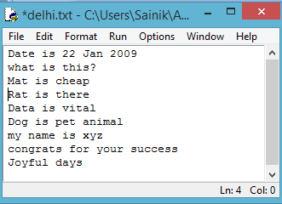
PROGRAMS
19. Write a function in Python to read the content of a text file “DELHI.TXT” and display all those lines on screen, which are Either starting with ‘D’ or starting with ‘M’.
DELHI.TXT File

Slide 138
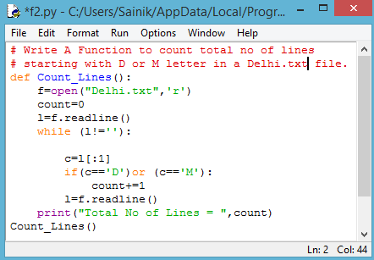
PROGRAMS

Slide 139
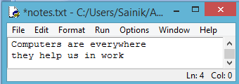
PROGRAMS
20. Write a function in Python to count the number of alphabets present in a text file “NOTES.TXT”.
NOTES.TXT FILE

Slide 140
PROGRAMS
20. Write a function in Python to count the number of alphabets present in a text file “NOTES.TXT”.
NOTES.TXT FILE

Slide 141
CBSE QUESTION PAPER QNO 4

Slide 142
CBSE QUESTION PAPER 2015 Delhi

Slide 143
CBSE QUESTION PAPER 2015 Delhi
4(a) Differentiate between the following : 1
(i) f = open(‘diary.txt’, ‘r’)
(ii) f = open(‘diary.txt’, ‘w’)
4(b) Write a method in python to read the content from a text file diary.txt line by line and display the same on screen. 2

Slide 144
CBSE QUESTION PAPER 2016 Delhi

Slide 145
CBSE QUESTION PAPER 2016 Delhi
(a) Write a statement in Python to perform the following operations : 1
To open a text file “BOOK.TXT” in read mode
To open a text file “BOOK.TXT” in write mode
4(b) Write a method in python to read the content from a text file diary.txt line by line and display the same on screen. 2

Slide 146
CBSE QUESTION PAPER 2017 Delhi

Slide 147
CBSE QUESTION PAPER 2017 Delhi
4 (a) Differentiate between file modes r+ and rb+ with respect to Python. 1
4(b) Write a method in Python to read lines from a text file MYNOTES.TXT, and display those lines, which are starting with the alphabet K 2

Slide 148
CBSE QUESTION PAPER 2018 AI

Slide 149
CBSE QUESTION PAPER 2018 AI
4 (a) Write a statement in Python to open a text file STORY.TXT so that new contents can be added at the end of it. 1
4 (b) Write a method in Python to read lines from a text file INDIA.TXT, to find and display the occurrence of the word ‘‘India’’. 2
For example :
If the content of the file is
‘‘India is the fastest growing economy.

Slide 150
CBSE QUESTION PAPER 2018 AI
India is looking for more investments around the globe.
The whole world is looking at India as a great market.
Most of the Indians can foresee the heights that India is capable of reaching.’’
The output should be 4. 2

Slide 151
ADDITIONAL PROGRAMS

Slide 152
ADDITIONAL PROGRAMS
Write a Python program to read an entire text file.
Write a Python program to read first n lines of a file.
Write a Python program to append text to a file and display the text.
Write a Python program to read last n lines of a file.
Write a Python program to read last n lines of a file.

Slide 153
ADDITIONAL PROGRAMS
Write a Python program to read a file line by line and store it into a list.
Write a Python program to read a file line by line store it into a variable.
Write a Python program to read a file line by line store it into an array.
Write a python program to find the longest words.
Write a Python program to count the number of lines in a text file.
Write a Python program to count the frequency of words in a file.

Slide 154
ADDITIONAL PROGRAMS
Write a Python program to read a file line by line and store it into a list.
Write a Python program to read a file line by line store it into a variable.
Write a Python program to read a file line by line store it into an array.
Write a python program to find the longest words.
Write a Python program to count the number of lines in a text file.
Write a Python program to count the frequency of words in a file.
Write a Python program to get the file size of a plain file
Write a Python program to write a list to a file.
Write a Python program to copy the contents of a file to another file.
Write a Python program to combine each line from first file with the corresponding line in second file.
Write a Python program to read a random line from a file.
Write a Python program to assess if a file is closed or not.
Write a Python program to remove newline characters from a file.

Slide 155
CLASS TEST
Class : XII Time: 40 Min
Topic: FILE HANDLING Max Marks: 40
Each Question carries 4 Marks
1. Write a program to count total no of spaces,words,characters,lines in a msg.txt file.
2.What is file?
3.Differentiate between text files and binary files.
4.Write a program to copy the content of notes.txt from 3rd character to till end of file to para.txt
5. Write a program to create binary file

Slide 156
Thank You

